Slide 1

Early prediction of Diabetes Mellitus using intensive care data
to improve clinical decisions
Date: 28 May 2021
Thumuluri Sai Sarika - 17WH1A0519
CH Aparna - 18WH5A0503
Y Kavya - 18WH5A0505
Internal Guide: Ms.Shanti Gunna
Designation: Assistant Professor
Department of Computer Science & Engineering
BVRIT HYDERABAD College of Engineering for Women

Slide 2

BACKGROUND
A patient’s overall health has been particularly important during the COVID-19 pandemic.
Intensive Care Units (ICUs) often lack verified medical histories for incoming patients.
A patient who is brought in unresponsive may not be able to provide information about chronic conditions such as heart disease, injuries, or diabetes.
Knowledge about chronic conditions such as diabetes can inform clinical decisions about patient care and ultimately improve patient outcomes.
BVRIT HYDERABAD College of Engineering for Women

Slide 3

Why Should I Study this course?
ABSTRACT
The objective is to build the model which determines whether a patient admitted to an ICU has been diagnosed with a particular type of diabetes, Diabetes Mellitus using data from the first 24 hours of intensive care
The aim is to focus on selecting the attributes that ail in early detection of Diabetes Mellitus using Predictive analysis with Logistic Regression and Light Gradient Boosting Machine techniques.
Examples
BVRIT HYDERABAD College of Engineering for Women

Slide 4
DATASET
Dataset Description:
The data is from MIT’s GOSSIS (Global Open Source Severity of Illness Score) initiative. The datasets consist of patient’s data from the first 24 hours of intensive care.
Training dataset - 130157 rows, 181 columns
Testing dataset - 10324 rows, 180 columns
Attribute | Description
encounter_id | Unique identifier associated with a patient unit stay
hospital_id | Unique identifier associated with a hospital
age | The age of the patient on unit admission

Slide 5
bmi | The body mass index of the person on unit admission
elective_surgery | Whether the patient was admitted to the hospital for an elective surgical operation
ethnicity | The common national or cultural tradition which the person belongs to
gender | The genotypical sex of the patient
height | The height of the person on unit admission
hospital_admit_source | The location of the patient prior to being admitted to the hospital
icu_admit_source | The location of the patient prior to being admitted to the unit
icu_admit_type | The type of unit admission for the patient
icu_id | A unique identifier for the unit to which the patient was admitted

Slide 6
icu_type | A classification which indicates the type of care the unit is capable of providing
pre_icu_los_days | The length of stay of the patient between hospital admission and unit admission
readmission_status | Whether the current unit stay is the second (or greater) stay at an ICU within the same hospitalization
weight | The weight (body mass) of the person on unit admission
albumin_apache | The albumin concentration measured during the first 24 hours which results in the highest APACHE III score
apache_2_diagnosis | The APACHE II diagnosis for the ICU admission
apache_3j_diagnosis | The APACHE III-J sub-diagnosis code which best describes the reason for the ICU admission

Slide 7
ARCHITECTURE
Applying Classification Algorithms
Logistic Regression
Random Forest
Intensive care patient dataset
Data Cleaning and Wrangling
EDA
LightGBM
XGBoost
Performance Evaluation
Evaluating Auc Roc Scores
Stratified K-Fold
Results
Data Visualization
K-folds
BVRIT HYDERABAD College of Engineering for Women

Slide 8
TECHNOLOGY STACK
Supervised Machine Learning
Python Language
Required Packages:
Numpy
Pandas
Os
Klib
Warnings
Matplotlib
Seaborn
lightgbm
sklearn
sklearn.linear_model.LogisticRegression
sklearn.ensemble.RandomForestClassifier
sklearn.model_selection

Slide 9
Hardware:
Processor - Intel Core i5
Memory(RAM) - 8 GB
Storage – I TB
Software:
Python3
Google Colab/Jupyter Notebook
SYSTEM SPECIFICATIONS

Slide 10
TIMELINE
Review 0 | Abstract Requirements and Specifications
Review 1 | Dataset collection Exploratory Data Analysis Data Cleaning and Wrangling
Review 2 | Applying Classification Algorithms
Review 3 | Interpretation of Results

Slide 11
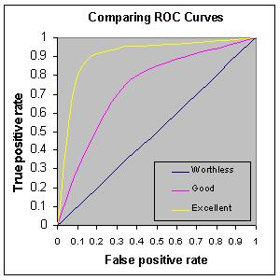
Evaluation Metric
Why AUC and ROC?
It measures the quality of the model's predictions irrespective of what classification threshold is chosen.
AUC - ROC curve is a performance measurement for the classification problems at various threshold settings.
An ROC curve plots two parameters:
True Positive Rate (TPR): it is defined as follows:
TPR = TP/TP+FN
False Positive Rate(FPR): it is defined as follows:
FPR = FP/FP+TN

Slide 12
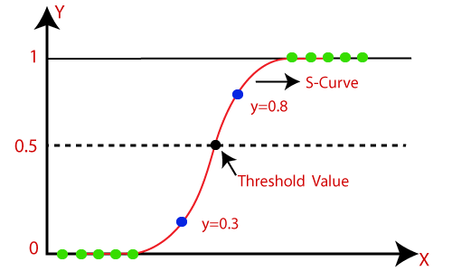
Logistic Regression
Logistic regression is easier to implement, interpret, and very efficient to train.It is very fast at classifying unknown records.
Why Logistic regression?
The sigmoid function is a mathematical function used to map the predicted values to probabilities.
The curve from the logistic function indicates
whether their is diabetes or not based on its
weight, etc.

Slide 13
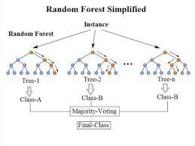
Random Forest
Random Forest is a process of combining multiple classifiers to solve a complex problem and to improve the performance of the model.
Why Random Forest ?
It takes less training time as compared to other algorithms.
It predicts output with high accuracy.
It reduces overfitting in decision trees and
helps to improve the accuracy.

Slide 14
XGBoost
Efficiently handling missing values
Parallelized
tree building
In-built cross validation capability
Tree pruning using depth-first approach

Slide 15
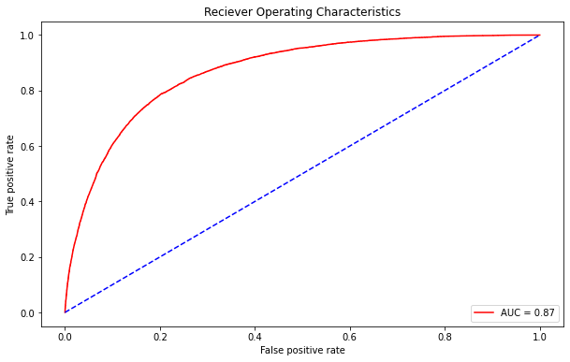
LGBM - Light Gradient Boosting Machine
Light GBM is a fast, distributed, high-performance gradient boosting framework based on decision tree algorithm, used for ranking, classification and many other machine learning tasks.
Why LGBM?
Suitable for large volumes of data
Hyperparameter Tuning
Faster training speed and higher efficiency
Lower memory usage

Slide 16
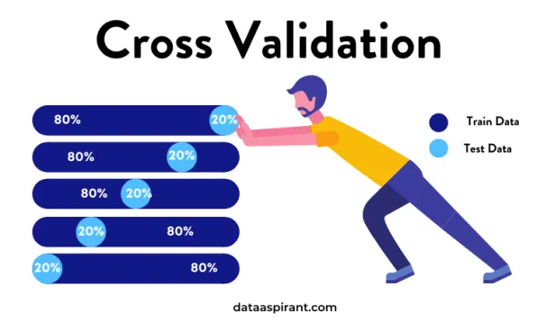
Why Cross Validation?
Use all the data
Get more metrics
Use models stacking
Work with Dependent/Grouped data
Parameters fine-tuning

Slide 17
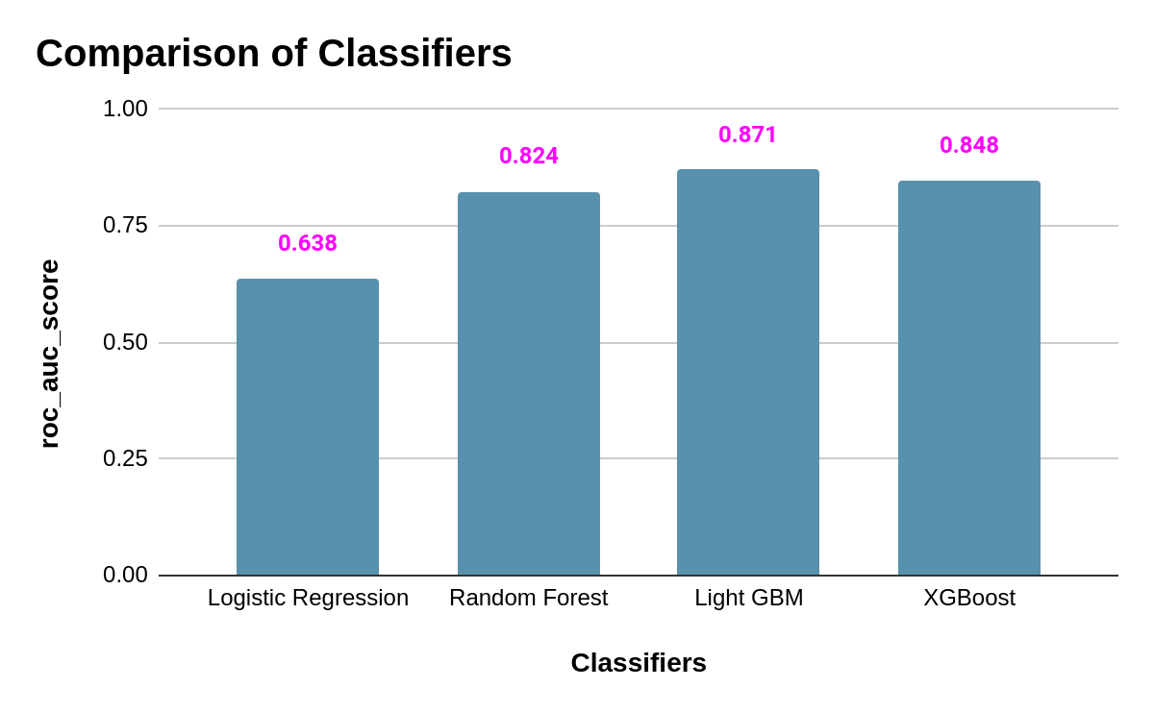

Slide 18
Base paper
Journal of King Saud University Computer and Information Sciences- Machine learning and artificial intelligence based Diabetes Mellitus detection and self-management:JyotismitaChakiaS.Thillai GaneshbS.KCidhambS.Ananda Theertan - https://www.sciencedirect.com/science/article/pii/S1319157820304134

Slide 19
References
Analysis of diabetes mellitus for early prediction using optimal features selection - https://journalofbigdata.springeropen.com/articles/10.1186/s40537-019-0175-6
Prediction of Diabetes Using Machine Learning Algorithms in Healthcare- https://ieeexplore.ieee.org/document/8748992
Predictive models for diabetes mellitus using machine learning techniques - https://bmcendocrdisord.biomedcentral.com/articles/10.1186/s12902-019-0436-6

Slide 20
Thankyou
BVRIT HYDERABAD College of Engineering for Women

